Slide 1
Processing of single-cell raw data
Theory

Slide 2
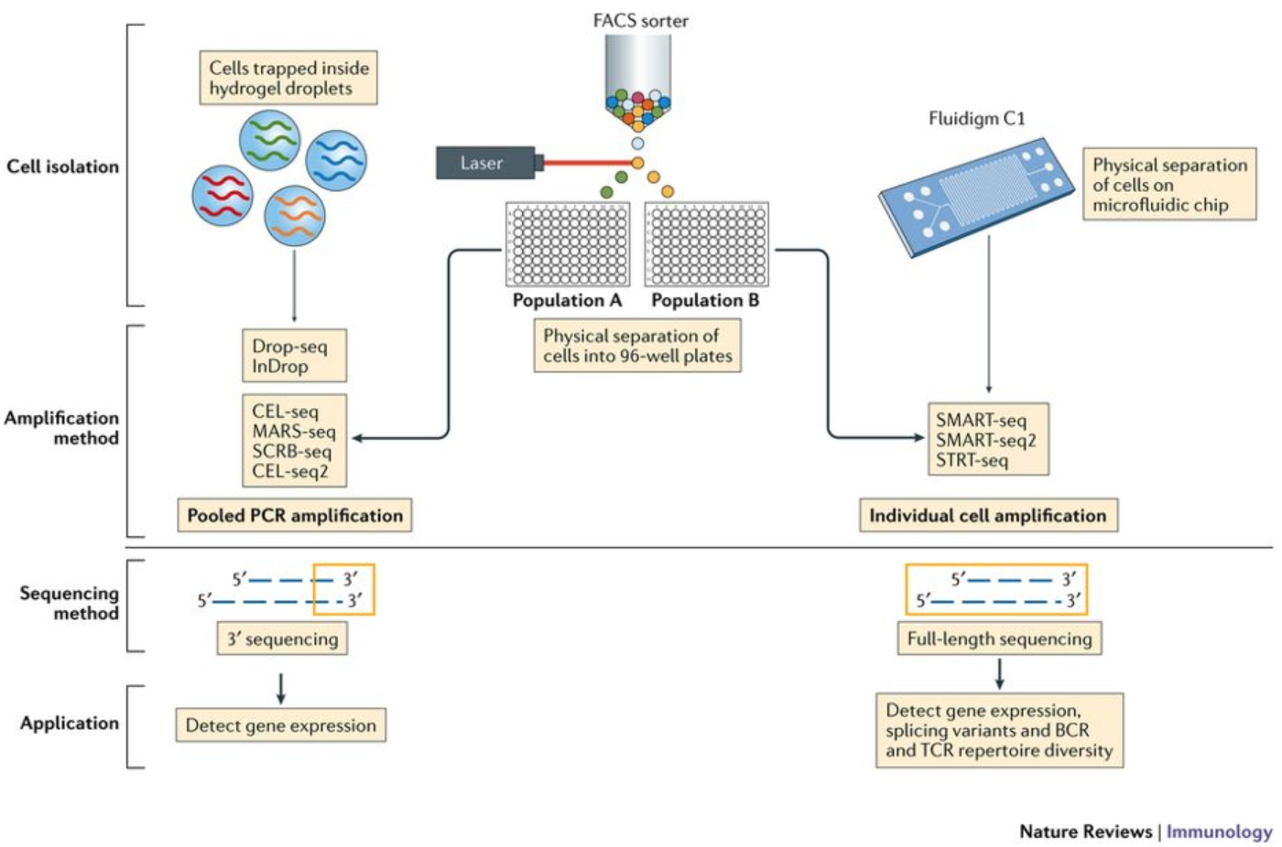
1. scRNA-seq raw data processing
The operational steps from raw data to count matrix are essentially the same for many scRNA-seq protocols.
Preprocessing of raw sequencing data varies depending on the library construction method, and RNA sequences (also called reads or tags) may be obtained from the 3' end (or 5' end) of the transcript (10X Genomics, CEL-seq2, Drop-seq, inDrops) or from the full-length transcript (Smart-seq2).
Notes:
Papalexi E and Satija R. Single-cell RNA sequencing to explore immune cell heterogeneity, Nature Reviews Immunology 2018 (https://doi.org/10.1038/ nri.2017.76)

Slide 3
The choice of library preparation methods involves biological questions of interest. The advantages of these methods are listed below.
3‘ (or 5’)-end library preparation
Distinguish biological replicates from PCR replicates using a unique UMI for more accurate quantification.
Sequencing a larger number of cells allows for better identification of cell type populations
The cost of a single cell is much lower.
The best results are >10,000 cells.
Full-length library preparation
Differences in the levels of isozymes (transcript isoforms) in expression can be detected.
Identify allele-specific differences in expression.
More in-depth sequencing of a smaller number of cells.
Best suited for samples with low cell counts.
This course focuses on data analysis of 3' end builds, mainly with droplet-based methods (inDrops, Drop-seq, 10X Genomics).

Slide 4
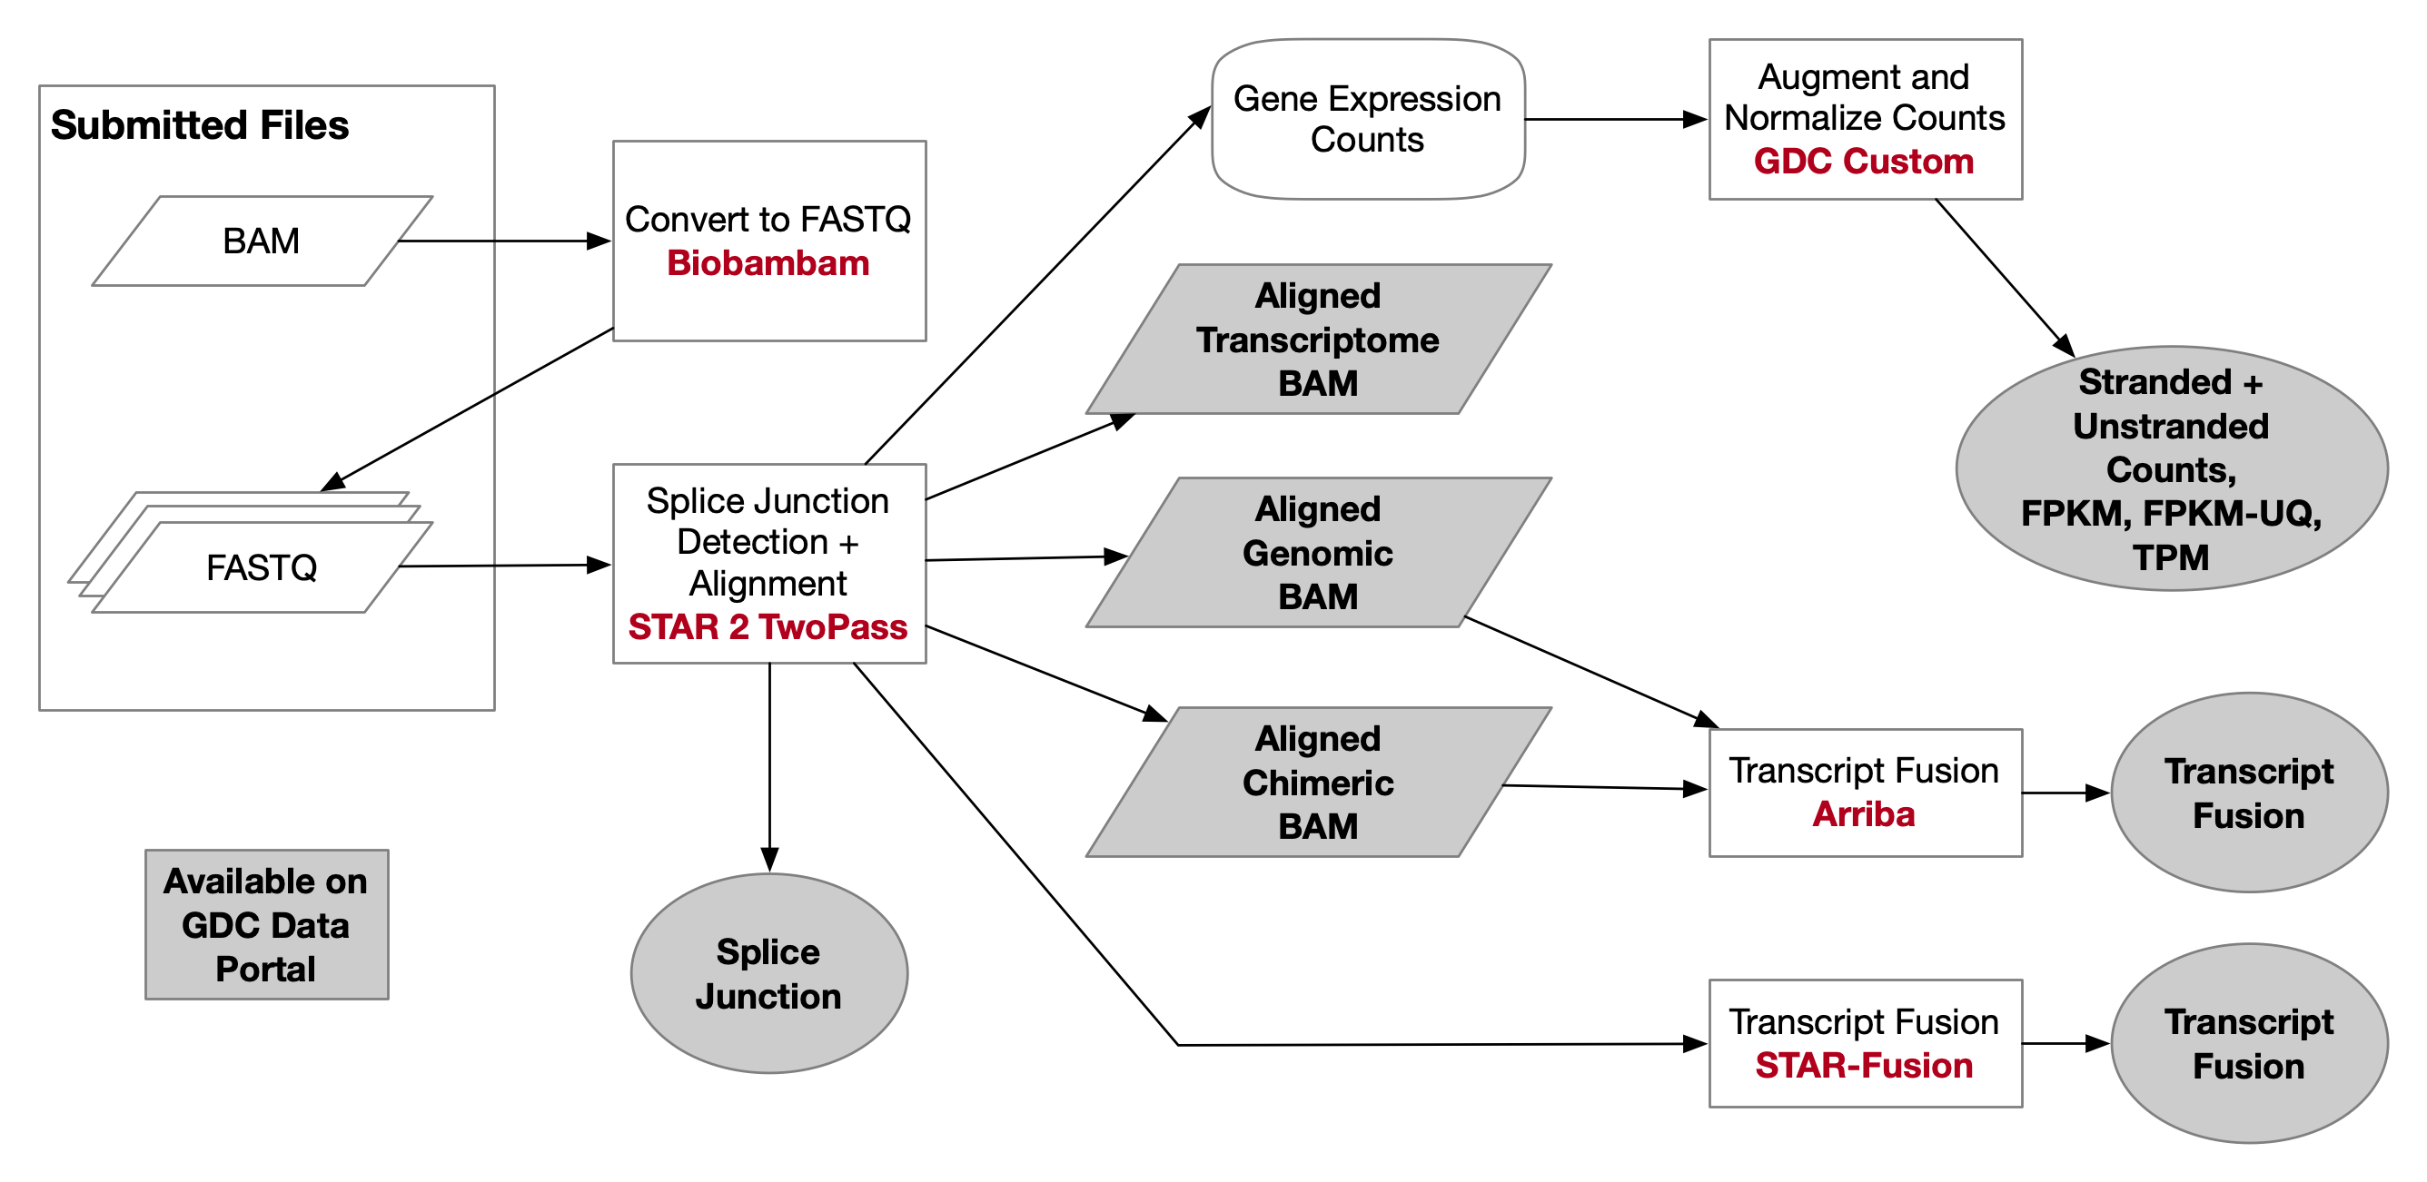
2. Raw data processing of Smart-seq2
The raw read processing is essentially the same as for bulk RNA-seq, including comparison and read counting. The two most popular tools currently available are STAR and hisat2.
https://www.ncbi.nlm.nih.gov/geo/query/acc.cgi?acc=GSM3847690
https://www.ncbi.nlm.nih.gov/geo/query/acc.cgi?acc=GSE175510
Notes:
https://docs.gdc.cancer.gov/Data/Bioinformatics_Pipelines/Expression_mRNA_Pipeline/

Slide 5
3. Raw data processing of 3' end sequencing (all droplet-based methods)
Single-cell RNA-seq data differs from bulk RNA seq in many ways. The sequence of reads generated by most scRNA-seq techniques contains three key pieces of information.
cDNA fragments: for quantifying gene expression levels
Cell Barcoding (CB): Identifies which cell the reads came from
UMI: Removal of technical duplicates such as PCR
Compared to bulk RNA-seq, scRNA-seq processes much less RNA and requires more PCR cycles. Therefore, UMI barcodes become very useful and are widely used in scRNAseq.
Library sequencing typically uses pairs of reads, where one read contains CB + UMI (read 1 in 10x Chromium) and the other contains cDNA sequences (read 2 in 10x Chromium).
A typical scRNA-seq data processing process consists of four steps
Mapping cDNA fragments to a reference sequence
Targeting reads to genes
Mapping reads to cells (cellular barcode demultiplexing)
Calculation of the number of UMI-RNA molecules (UMI repeat calculation)
Generating a count matrix containing genes, cells and read count

Slide 6
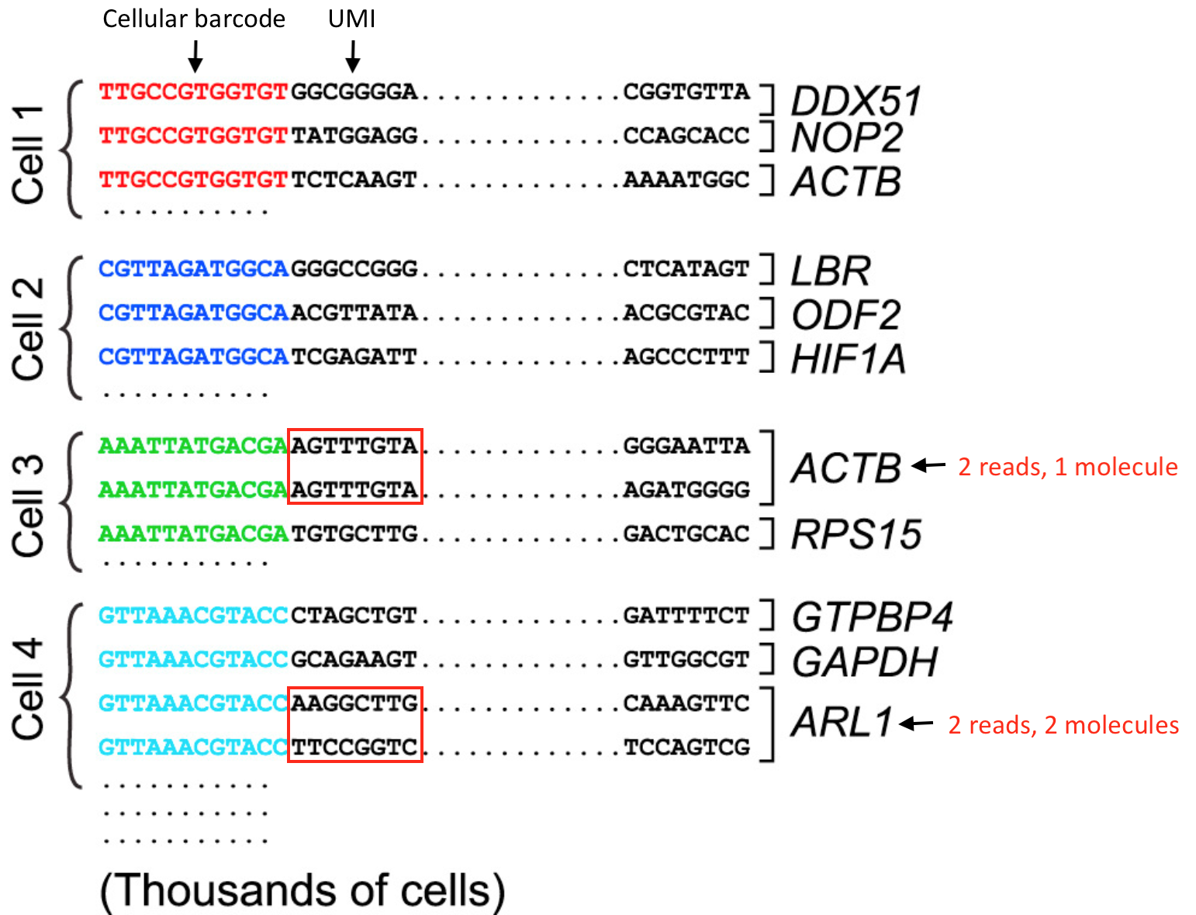
4. Structure of sequencing read
For the analysis of scRNA-seq data, it is helpful to understand what information is present in each read and how we can use this information in analysis.
For the 3' end sequencing method, reads from different molecules of the same transcript will only come from the 3' end of the transcript, so it is likely to have the same sequence. However, the PCR step in the library preparation process may also generate read duplicates. To determine whether a read is a biological duplicate or a technical duplicate, we use the UMI technique.
Different UMIs mapped to the same transcript are read from different molecules that are biological duplicates - each read should be counted.
Reads with the same UMI from the same molecule are technically duplicates - the UMI should be excluded and counted as a single read.
In the schematic on the right, the ACTB reads should be combined and calculated as one read, while the ARL1 reads should be calculated separately.
Notes:
Macosko EZ et al. Highly Parallel Genome-wide Expression Profiling of Individual Cells Using Nanoliter Droplets, Cell 2015 (https://doi.org/10.1016 /j.cell.2015.05.002)

Slide 7
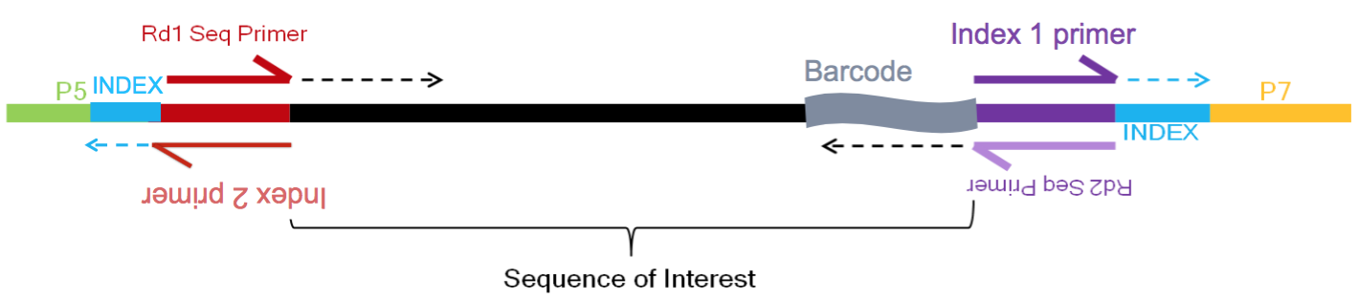
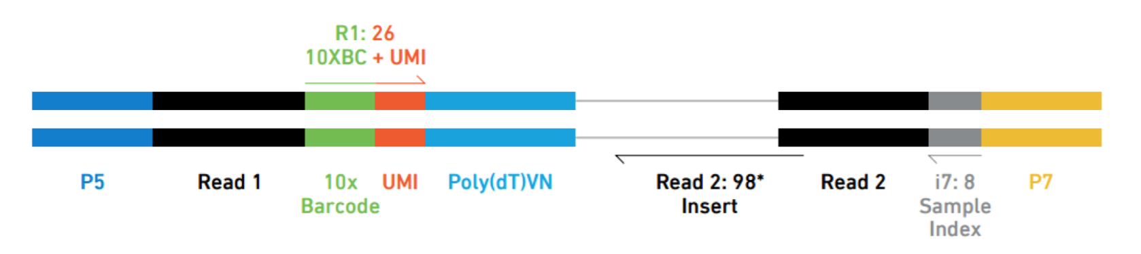
Example 1
Library information for the inDrops method
R1 (61bp): read sequence (red top arrow).
R2 (8bp index (i7)): cell barcode - which cell the read came from (purple top arrow).
R3 (8bp index (i5)): sample/library index - source of the sample read (red bottom arrow).
R4 (14 bp Read 2): read2 and the source of the remaining CB and UMI - transcript read (purple bottom arrow).
10X method of library building

Slide 8
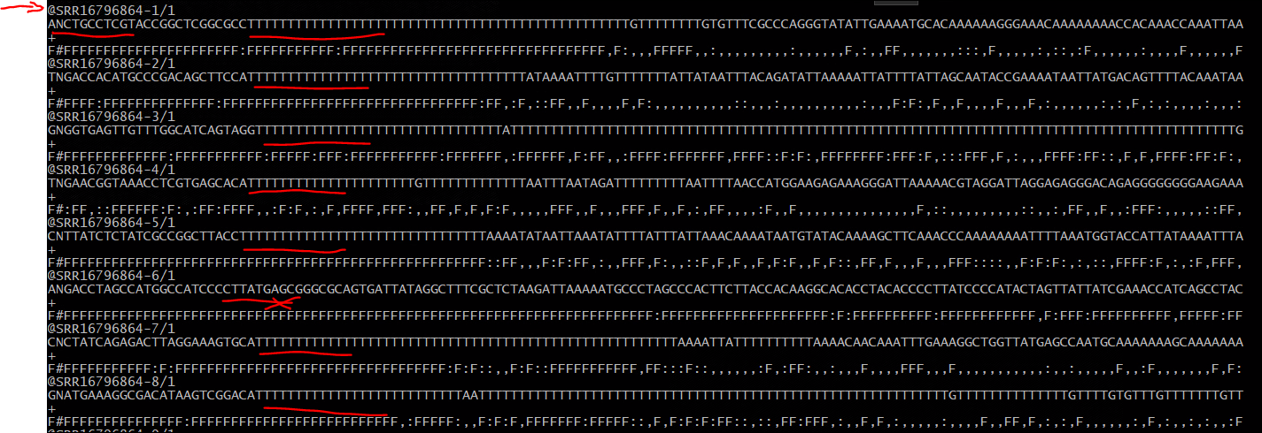
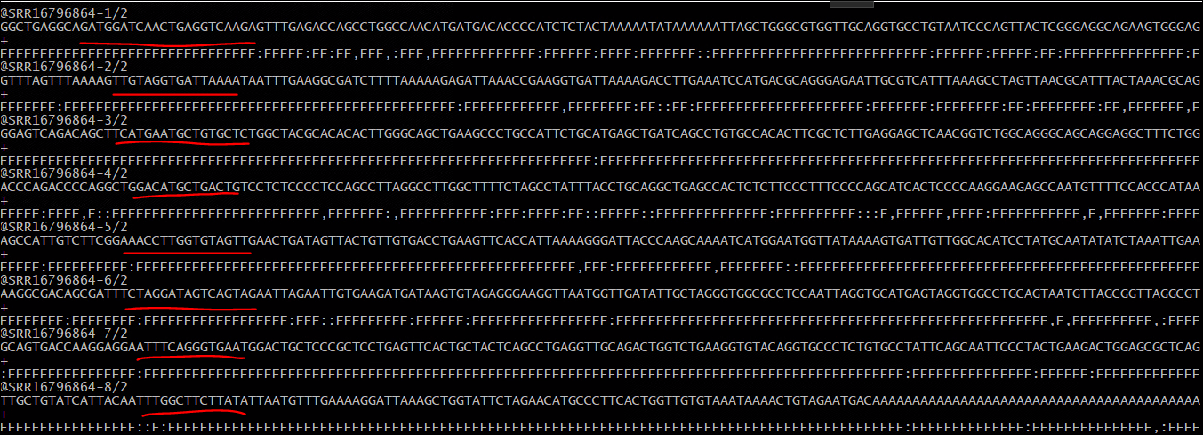
Example 2: 10X of reads
Read 1
Regardless of the droplet method used, the following conditions are required for proper quantification at the cellular level
Sample index: determines from which sample the read was added during the library preparation process
Cellular barcode: identifies the cell from which the read comes, and each library preparation method has a CB used in the library preparation process
Unique molecular identifier (UMI): determines which transcript molecule the read comes from UMI will be used to fold the PCR repeat sequence
Read 2

Slide 9
5. Raw data processing of 10x genomics
Cell Ranger is the default tool for processing 10x Genomics Chromium scRNAseq data using the STAR comparison tool.
Cell Ranger is a set of analysis pipelines for processing Chromium single-cell data, including comparing reads, generating feature barcode matrices, performing clustering and other advanced analyses, etc.
Cell Ranger includes five pipelines associated with 3' single cell gene expression solutions and products.
cellranger mkfastq
cellranger count
cellranger multi
cellranger aggr
cellranger reanalyze

Slide 10
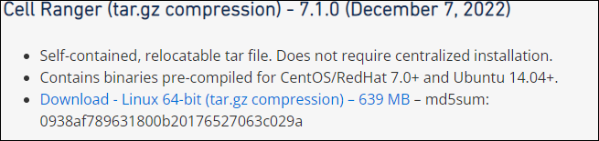
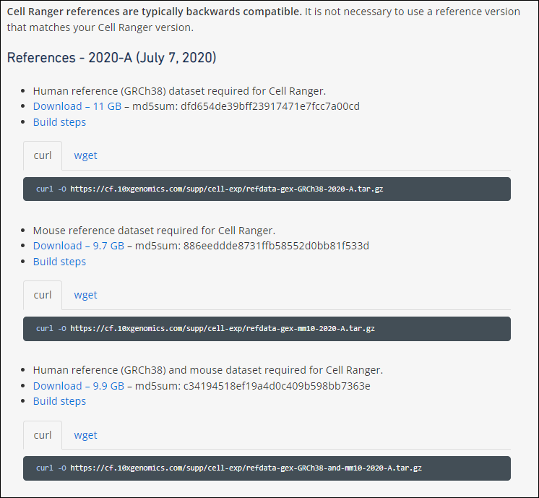
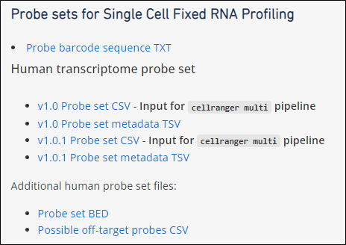
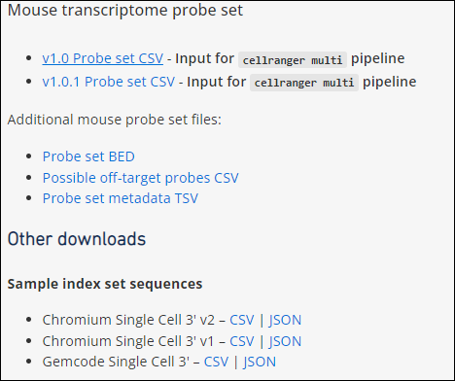
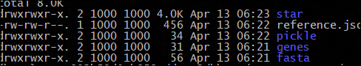
Cell ranger tool: Users can download from the official website at
https://support.10xgenomics.com/single-cell-gene-expression/software/downloads/latest

Slide 11
6. The reference genome
There are two most frequently used genomic versions: UCSC (e.g. hg19, hg38, mm10, etc.) and GRC (GRCh37, GRCh38, GRCm38). Their main chromosomal versions are identical (chr1-chr22,chrX/Y/M). The main differences is the contigs and ALT loci.
https://lh3.github.io/2017/11/13/which-human-reference-genome-to-use
Genome annotation files are usually saved in GTF/GFF3 format, including gene, transcript, exon, intron and other location information. Each gene has a unique ID number (starting with ENSG), and each gene generally corresponds to multiple transcripts (starting with ENST).
The main annotation file sources are RefSeq, ENSEMBL and GENCODE.
RefSeq is the most conservative of these and tends to have the fewest annotated transcripts per gene. RefSeq transcript IDs start with NM_ or NR, e.g. NM_12345.
ENSEMBL and GENCODE are very similar and can be used interchangeably. The gene names in these begin with ENSG (for humans) and ENSMUSG (for mice);
Transcripts begin with ENST and ENSMUST, respectively.
The current ENSEMBL/GENCODE annotation of the human genome contains approximately 60,000 genes, 20,000 of which are protein-coding genes, with 237,000 transcripts.
Most genes can be roughly classified by type into protein-coding genes, long non-coding RNAs, short non-coding RNAs, and pseudogenes.

Slide 12
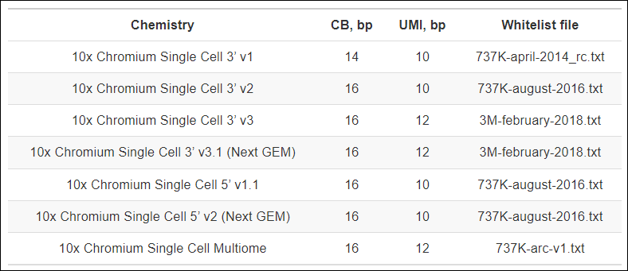
7. White list and 10X genomics version
Cell barcode sequences are synthetic sequences attached to beads that identify individual cells. The unique sequence library is called a whitelist. Cell Ranger uses a specific algorithm to correct the original CB sequence based on the whitelist sequence. Chromium library versions correspond to different whitelist lists and the file can be obtained from the Cell Ranger repository.
Chromium uses three whitelists: 737K-april-2014_rc.txt, 737K-august-2016.txt, and 3M-february-2018.txt. CB in the first file is 14bp long, and the other two are 16bp. The following table provides the popular 10X single-cell sequencing kits of CB and UMI lengths, as well as the corresponding whitelist files.
The corrected barcodes are used in all downstream analysis. In the output BAM file, the original uncorrected barcode is encoded in the CR tag, while the corrected barcode sequence is encoded in the CB tag. Reads that cannot be assigned to corrected barcodes will not have a CB tag.

Slide 13
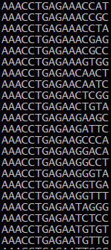
Example 3: whitelist

Slide 14
8. Transcript quantification
Read count is calculated by the following pre-processing steps.
Correction of sequencing errors in UMI sequences. If there is a base inconsistency in the UMI when comparing reads with the same BC to the same gene, such a UMI sequence will be corrected to a UMI sequence with a higher support rate.
For reads that match to multiple genes (with the same barcode and UMI), the gene with the most supported reads will be kept for counting, and the remaining reads will be discarded. If the number of supported reads is the same, all of them are discarded (it is not possible to determine exactly which gene they belong to).
After these two filtering steps, the read count matrix file is generated, and the BC information and UMI information are also output.

Slide 15
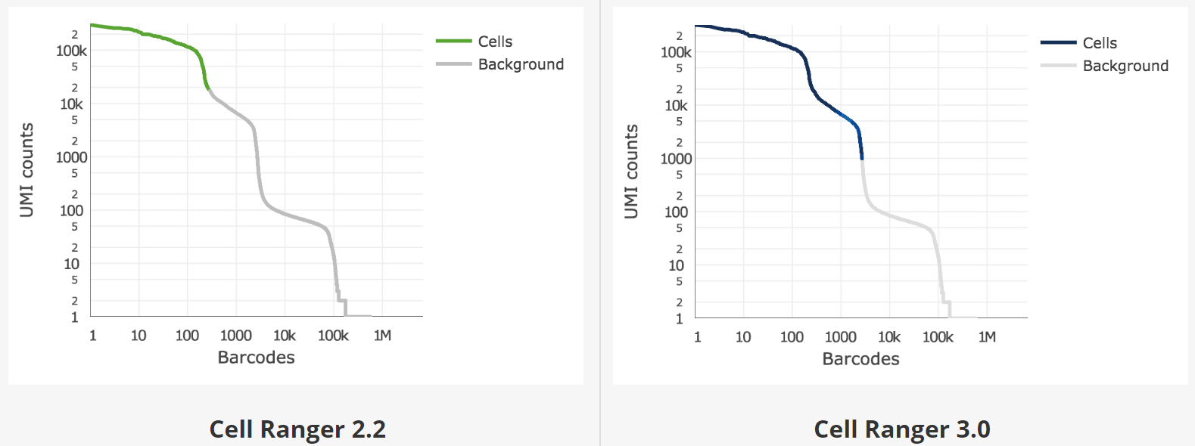
9. Low quality cell filtering
The unfiltered read count matrix contains many columns with 0, effectively empty droplets, such as the presence of environmental RNA from fragmented cells. cell ranger has two filtering algorithms.
The original algorithm determined the first "knee point" in the "number of barcodes vs. UMI per barcode" plot.
Cell Ranger 3.0 introduces an improved cell counting algorithm that better identifies populations of cells with low RNA content, especially when low RNA content cells are mixed with high RNA content cell populations. For example, tumor samples often contain large tumor cells mixed with smaller tumor infiltrating lymphocytes (TIL), and some researchers may be particularly interested in TIL populations.

Slide 16
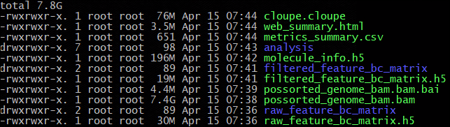
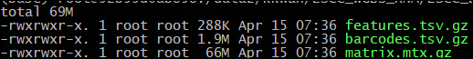
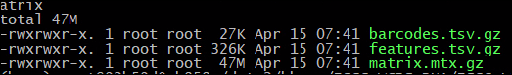
Example 4: The output of cellranger

Slide 17
10. Alternative tools to Cell ranger
STARsolo and Alevin-full-decoy: two tools that balance speed and accuracy
STARsolo is a solution for analyzing drop-scRNA sequencing data (e.g. 10X Genomics Chromium system) that is integrated into the STAR program.
STARsolo accept the raw fastq files:
Error correction and demultiplexing of CBs using user-entered whitelist.
Mapping reads to the reference genome using the standard STAR splice read alignment algorithm.
Error correction and collapse (duplicate removal) of Unique Molecular Identifiers (UMI)
Quantifying gene expression for each cell by counting the number of reads for each gene.
Quantification of other transcriptome features: splice junctions; pre-mRNA; splice/non-splice reads similar to Velocyto
STARsolo's output is designed to be a direct replacement for the 10X CellRanger. It follows the logic of CellRanger's cell barcode whitelisting and UMI de-duplication and produces nearly identical gene counts in the same format. At the same time STARsolo is about 10 times faster than CellRanger.

Slide 18
Running STARsolo
STARsolo operates in the same way as normal STAR operation, with the addition of a few STARsolo parameters.
Run the command: /path/to/STAR --genomeDir /path/to/genome/dir/ --readFilesIn ... [... ...other parameters...] --soloType ... --soloCBwhitelist ...
The reference genome is the same as that used for normal STAR.
--soloType Droplet/CB_UMI_Simple
--soloCBwhitelist /path/to/cell/barcode/whitelist
--soloUMIlen 12 (CB=16b, UMI=10b)
--readFilesIn cDNAfragmentSequence.fastq.gz CellBarcodeUMIsequence.fastq.gz
Note: The standard 10X run is Read2 for cDNA and Read1 for barcodes.
Several versions of CellRanger annotations are available for 10X:
https://support.10xgenomics.com/single-cell-gene-expression/software/downloads/latest
For the best match, the annotations in the CellRanger run and the STARsolo run should be identical.
--genomeSAsparseD 3
You can also prepare your own comment files

Slide 19
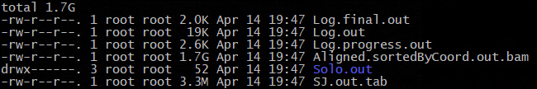
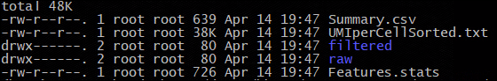
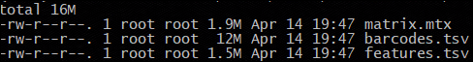
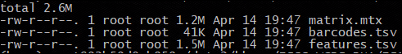
Example 5: The output of STAR-solo

Slide 20
Useful references
https://github.com/alexdobin/STAR/blob/master/docs/STARsolo.md
https://www.labome.com/method/RNA-seq.html
https://support.10xgenomics.com/single-cell-gene-expression/software/downloads/latest
https://swaruplab.bio.uci.edu/tutorial/tutorial.html
https://hbctraining.github.io/scRNA-seq/schedule/
https://bioconductor.org/books/release/OSCA/index.html

